Slide 1
First Middle Last
My 3rd Grade
Digital Autobiography

Slide 2
Name’s Favorites
Favorite Color:
Favorite Food:
Favorite T.V. Show:
Favorite Season:
Favorite Subject:
Favorite Book:
Favorite Place:
Favorite Song:
Favorite Activity:
Favorite Person:
Favorite Holiday:

Slide 3
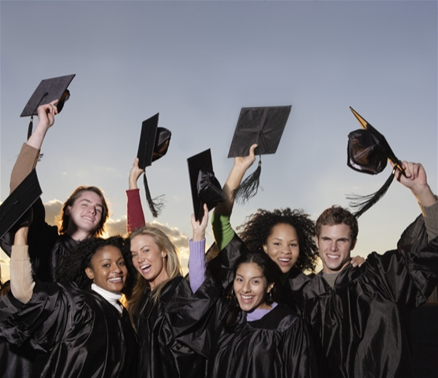
My Personal Number Museum
Birthday:
Graduation Year:
Time you were born:
Phone Number:
Address Number:
Favorite Number:
Number of Teeth Lost:
Shoe Size:

Slide 4
My School Years
 | School Name | Teacher Name | City & State
Kindergarten
1st Grade
2nd Grade
3rd Grade
4th Grade
5th Grade

Slide 5
My Vocabulary Wall
Science | Social Studies | Math | Literacy | Other

Slide 6
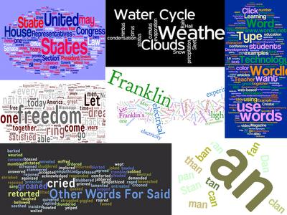
My 3rd Grade Wordle

Slide 7
Otters SWIM
S
W
I
M

Slide 8
8 Things I Want My Class To Know About Me
_________________
_________________
_________________
_________________
_________________
_________________
_________________
_________________
Add photo here to match one of your facts to the left.

Slide 9
My Third Grade Goal(s)
Please write three goals you have for third grade. Goals are things you want to happen this year. Goals are promises you make to yourself. You will be working towards these goals all year.
1.
2.
3.

